Slide 1

Lithium-Ion Battery Aging Dataset: Analysis and Insights
Yusuf Abdullatif-Ahmet Hakan Yıldız
2100006330-2000003057

Slide 2

Importing data

Slide 3
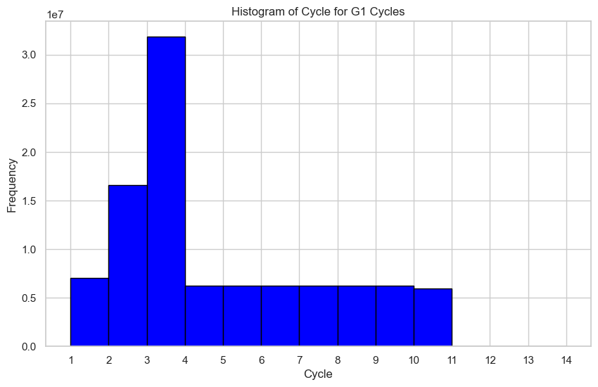
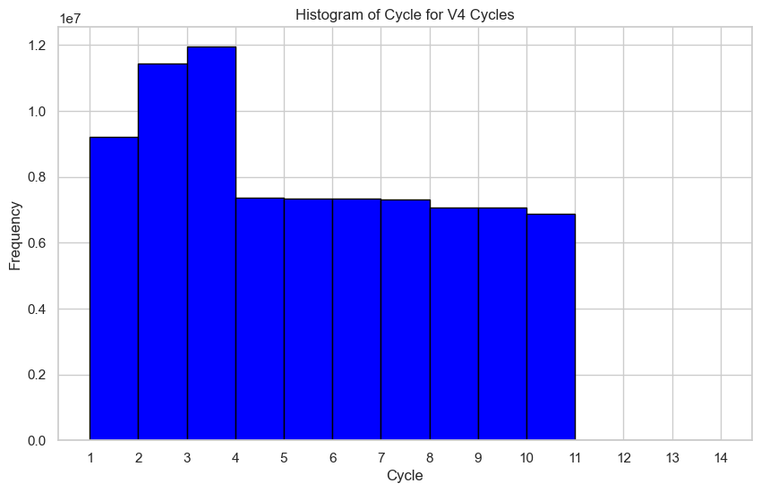
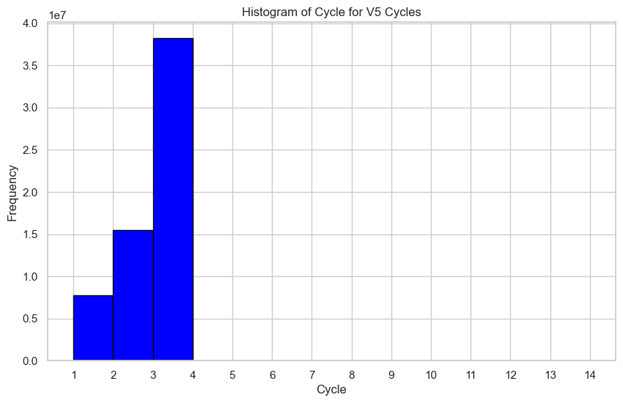
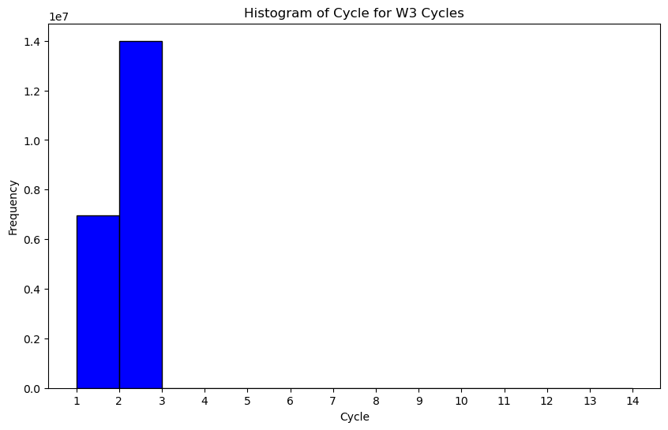
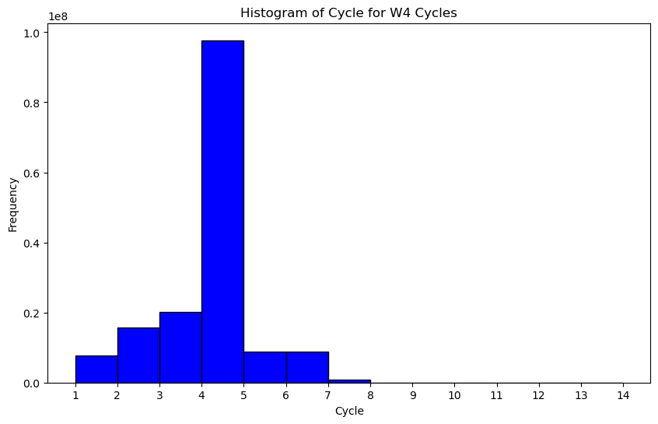
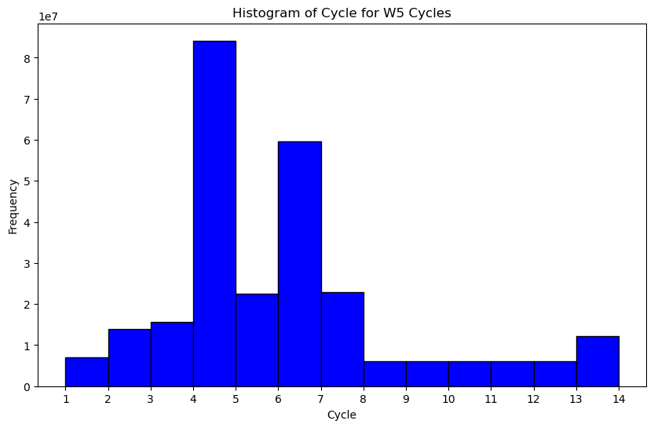
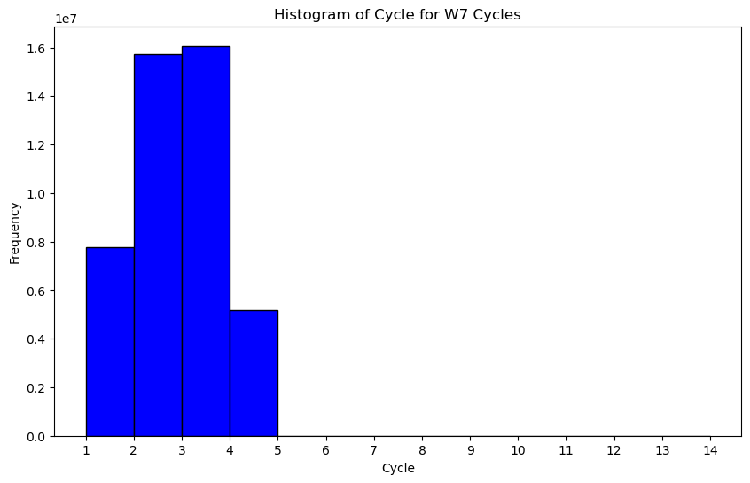
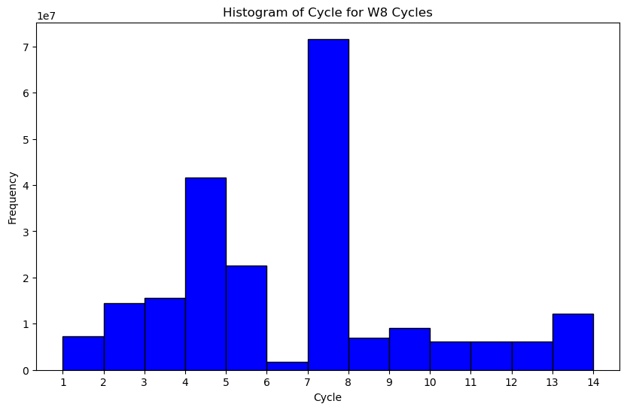
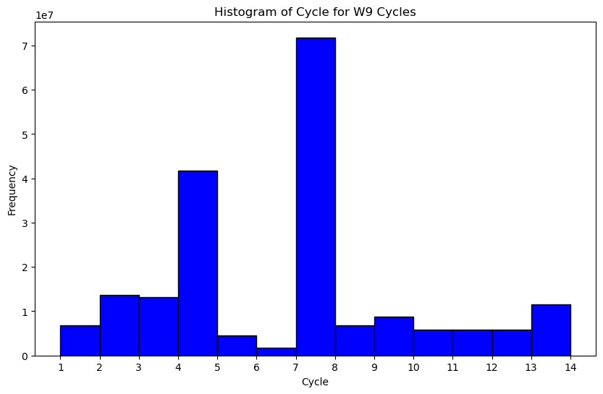
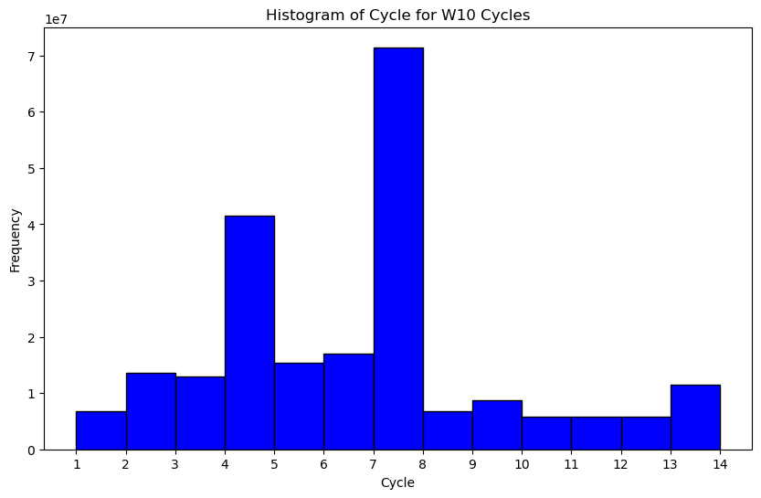
Analysing Cycles

Slide 4
Analysing Diagnostic Tests
Capacity Test
Measures the battery’s ability to store and deliver energy
Determines the battery’s usable energy capacity
Electrochemical Impedance Spectroscopy Test
Analyzes the battery's resistance to electrical current at different frequencies.
Provides insights into the battery's internal resistance, which affects charging speed and power delivery.
Hybrid Pulse Power Characterization (HPPC) Test
Simulates real-world driving conditions by subjecting the battery to repeated charge and discharge cycles with varying power levels.
Evaluates the battery's power delivery capabilities under different load conditions, providing information on its suitability for various applications.

Slide 5
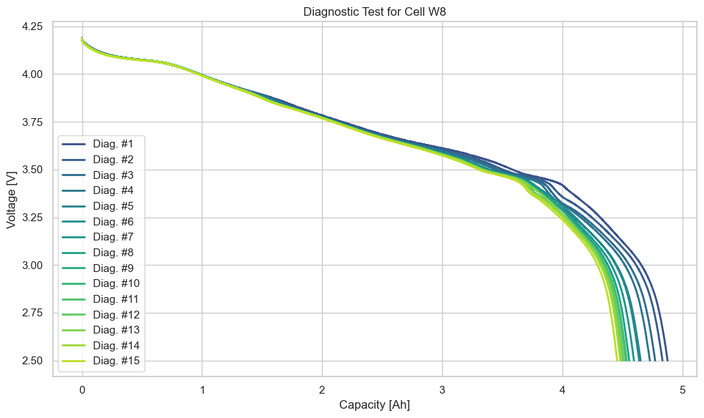
W8 Capacity test
Voltage: The electrical potential difference between two points in a circuit. In batteries, it's the driving force that pushes electrons from the negative terminal to the positive terminal.
Capacity: The amount of electrical charge a battery can store and deliver. It's typically measured in Ampere-hours (Ah) or Watt-hours (Wh).

Slide 6
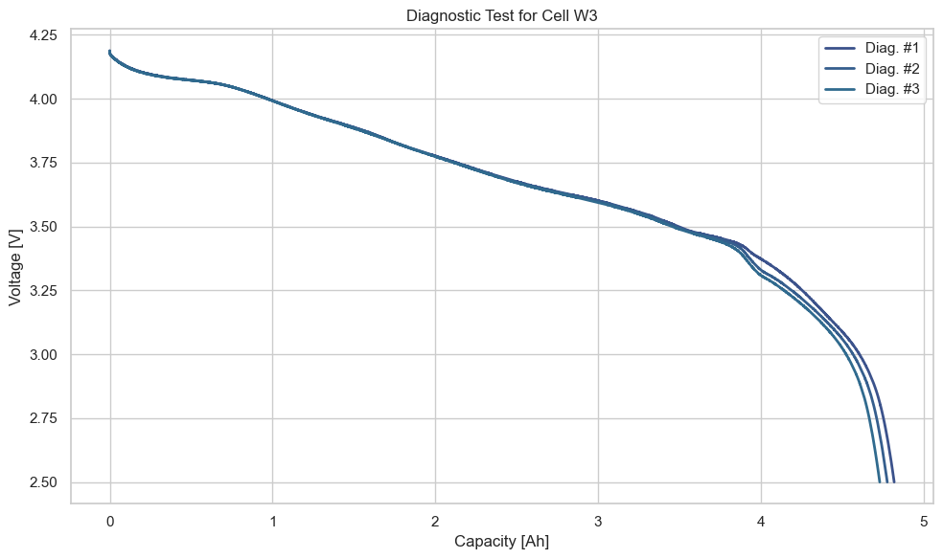
W3 Capacity tests

Slide 7
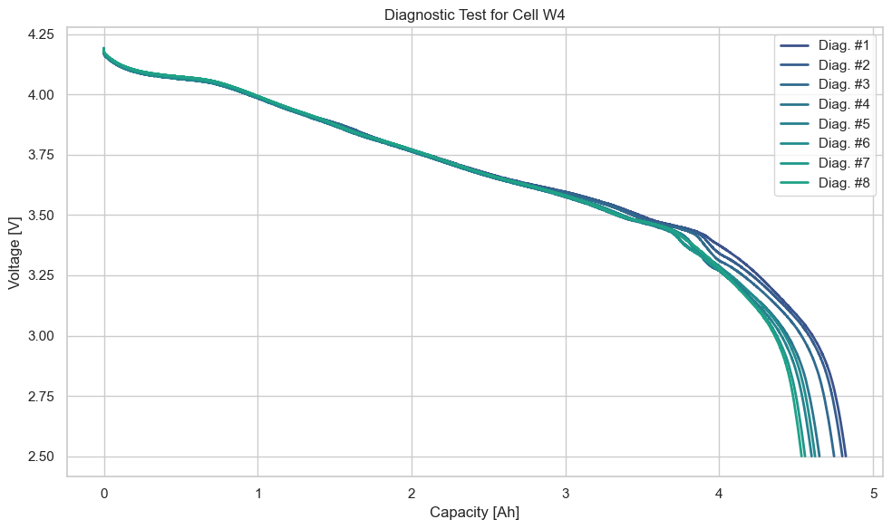
W4 Capacity test

Slide 8
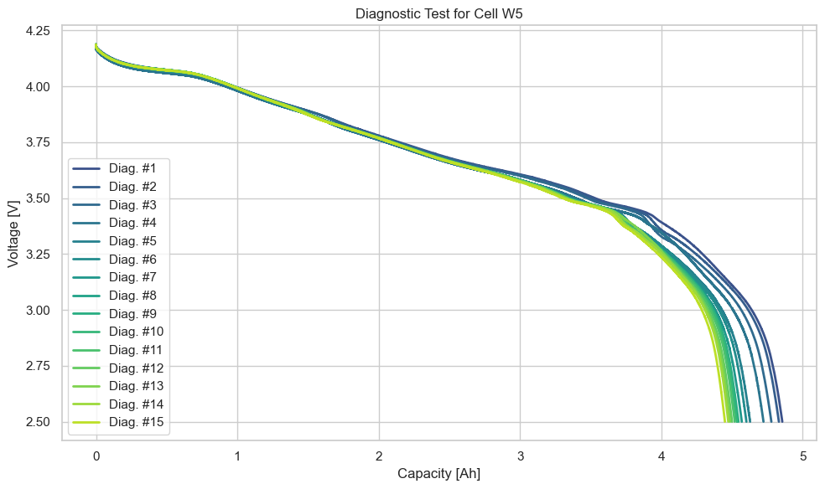
W5 Capacity test

Slide 9
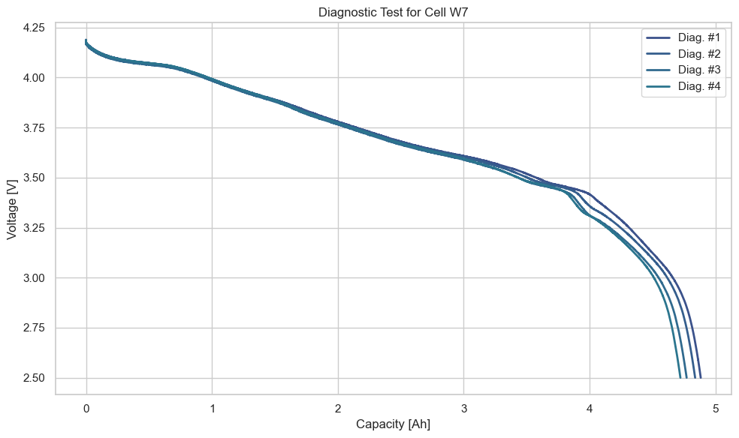
W7 Capacity test

Slide 10

W9 Capacity test

Slide 11

W10 Capacity test

Slide 12
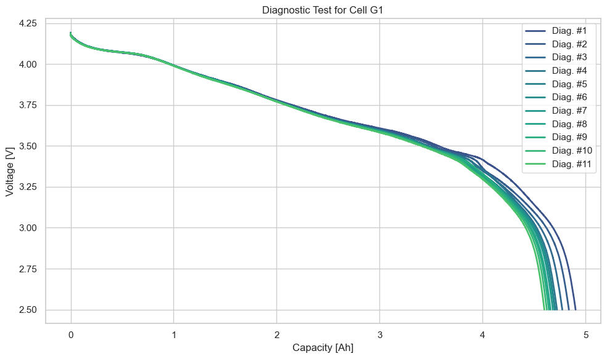
G1 Capacity test

Slide 13
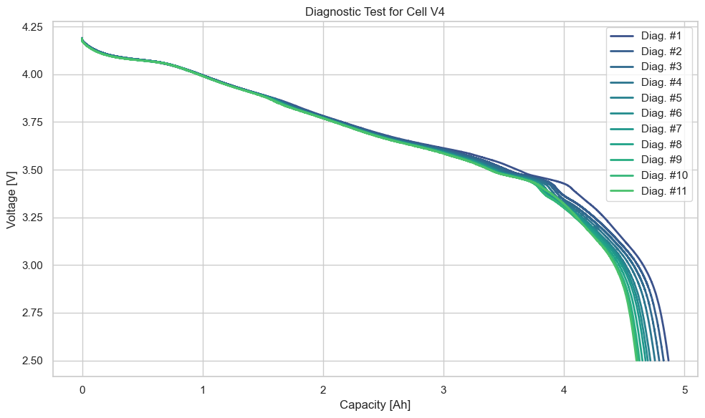
V4 Capacity test

Slide 14
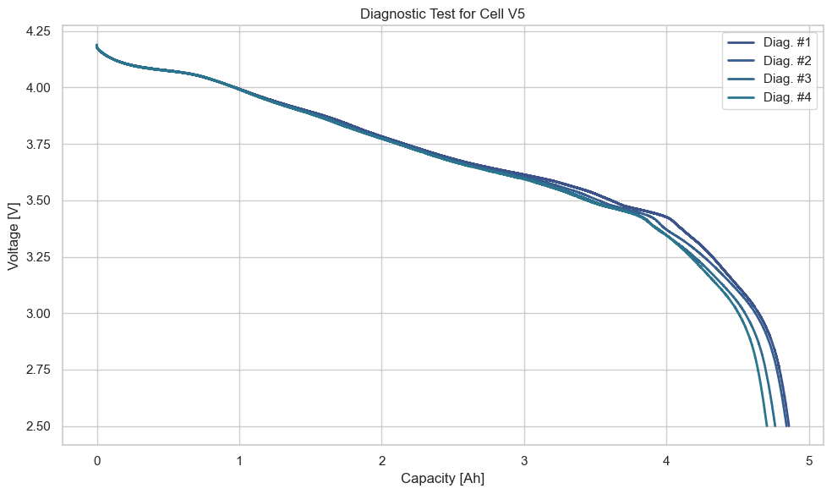
V5 Capacity test

Slide 15
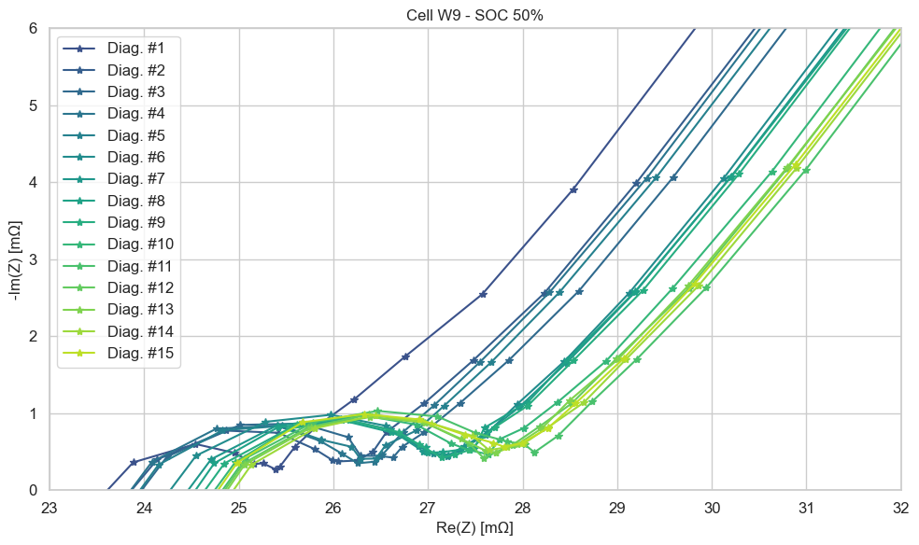
EIS TEST
Smaller Semi-Circle: Indicates lower internal resistance, which generally translates to better battery performance, faster charging, and higher power output.
Larger Semi-Circle: Suggests higher internal resistance, potentially leading to slower charging, lower power output, and reduced cycle life.
Shift in Semi-Circle Position: A shift in the semi-circle's position can indicate changes in the cell's electrochemical properties, such as degradation or aging.

Slide 16
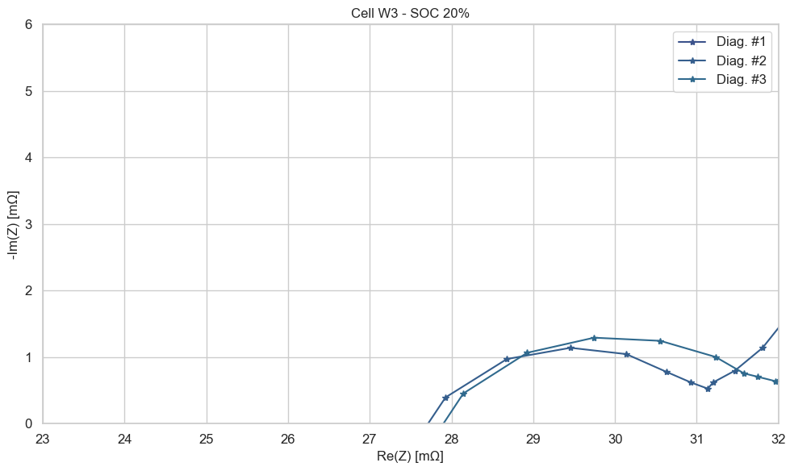
W3 EIS Test

Slide 17
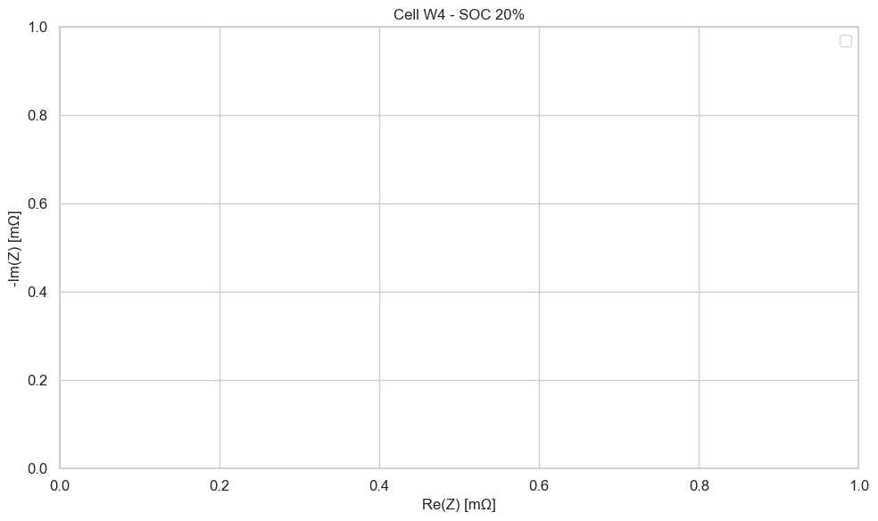
W4 EIS Test

Slide 18

W5 EIS Test

Slide 19

W7 EIS Test

Slide 20
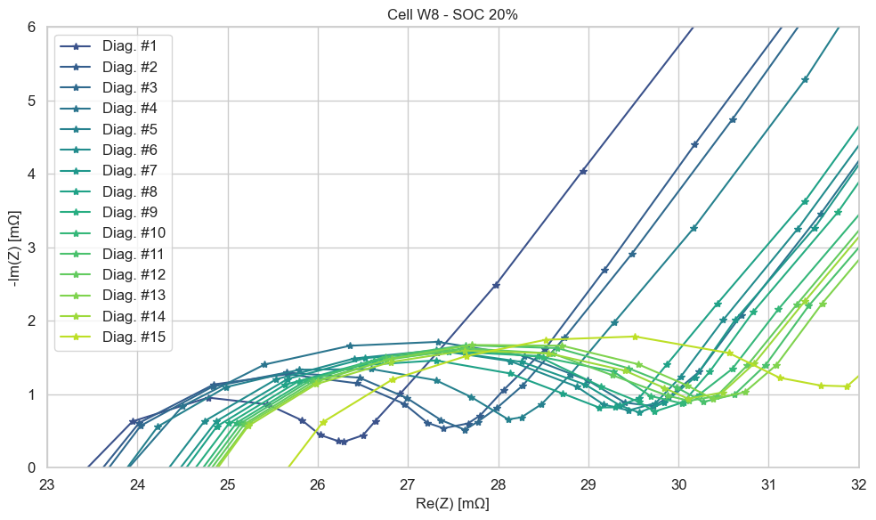
W8 EIS Test

Slide 21
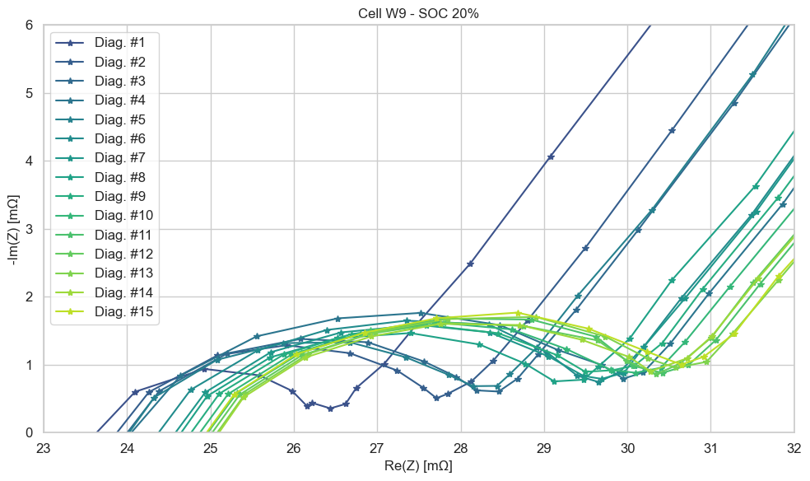
W9 EIS Test

Slide 22
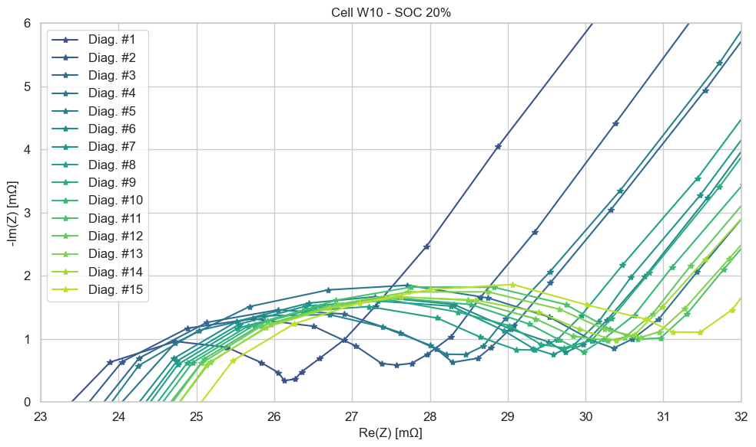
W10 EIS Test

Slide 23
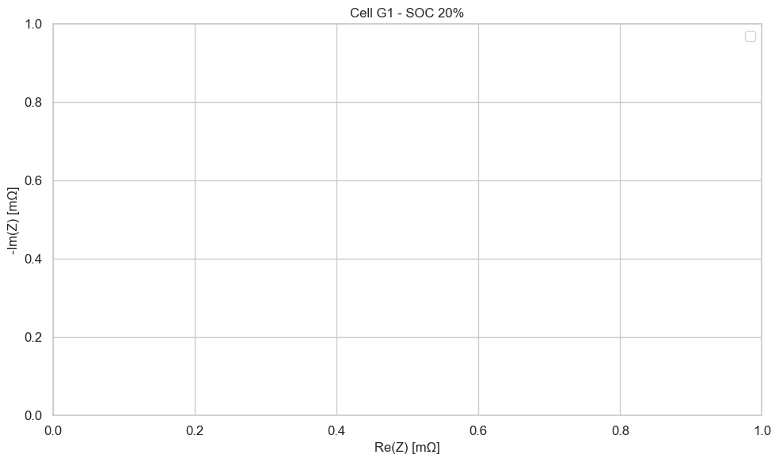
G1 EIS Test

Slide 24
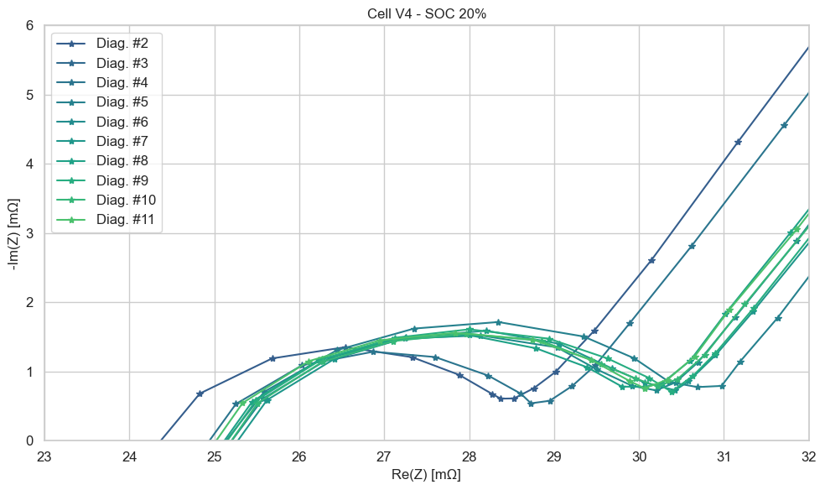
V4 EIS Test

Slide 25
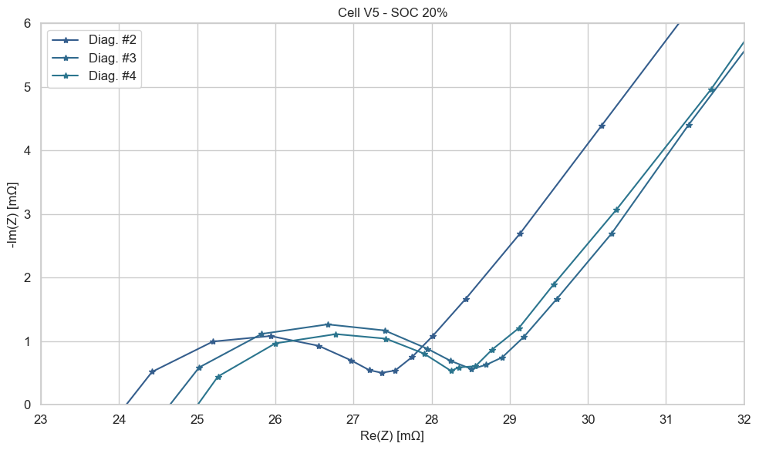
V5 EIS Test

Slide 26
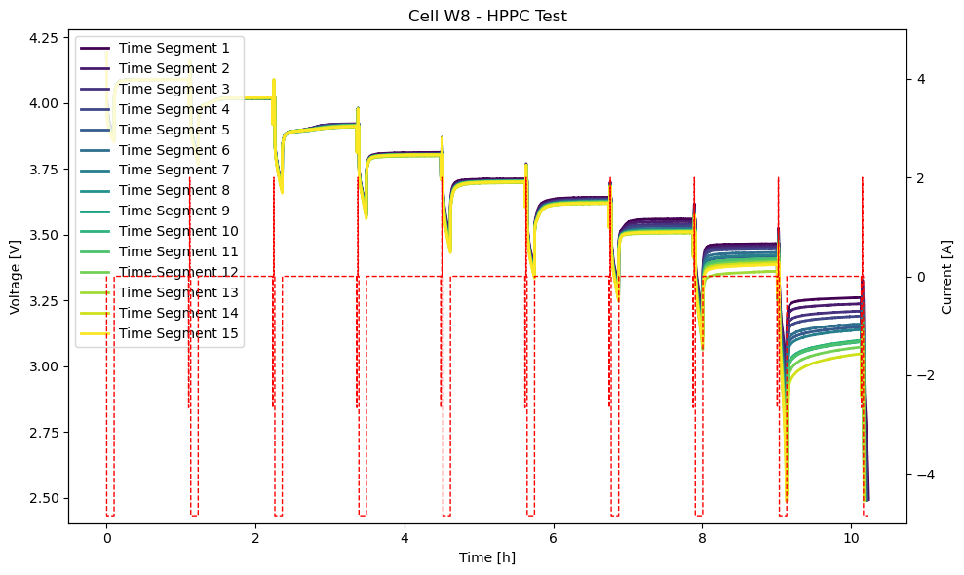
W8 HPPC Test
Steeper Voltage Drop during Discharge: Aged batteries exhibit a more rapid voltage drop during high-current discharge pulses.
Slower Voltage Recovery during Charge: The voltage recovery after a discharge pulse is slower in aged batteries.
Reduced Power Capability: The peak power that the battery can deliver decreases due to increased internal resistance.

Slide 27
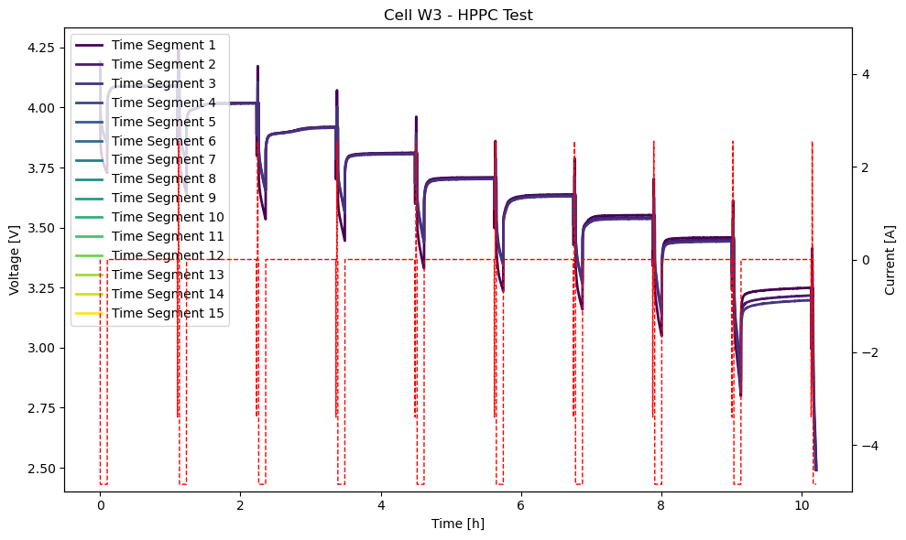
W3 HPPC Test

Slide 28
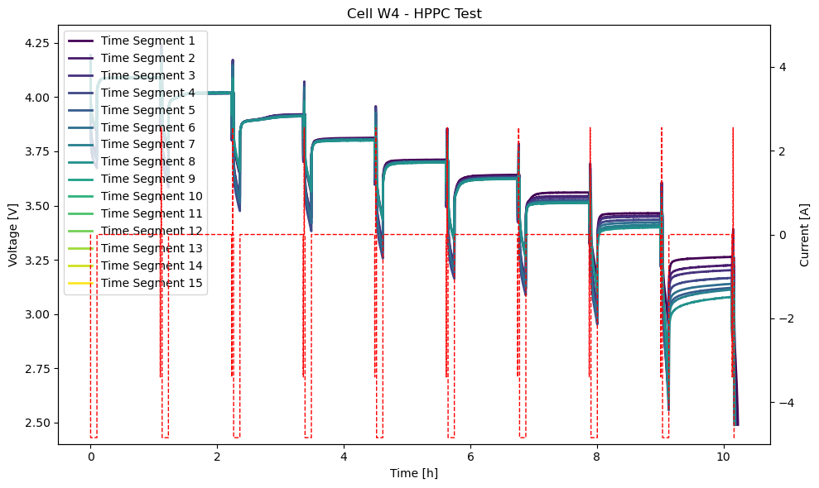
W4 HPPC Test

Slide 29
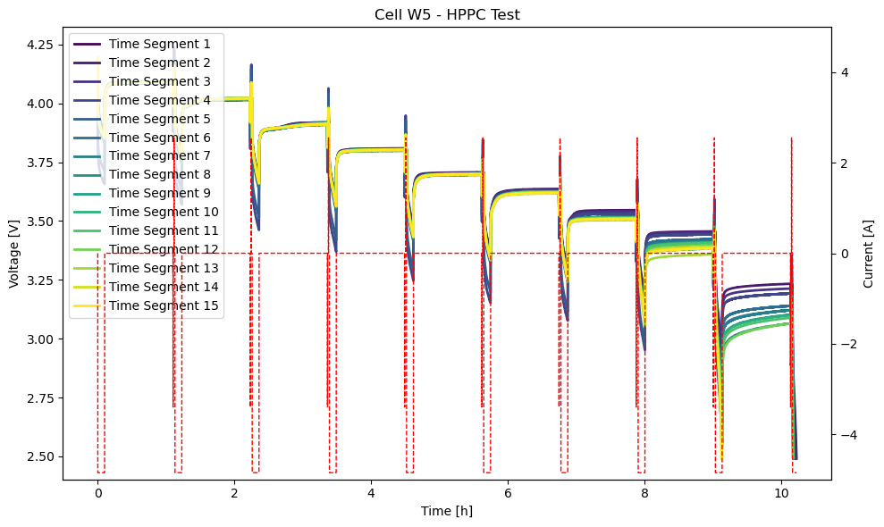
W5 HPPC Test

Slide 30
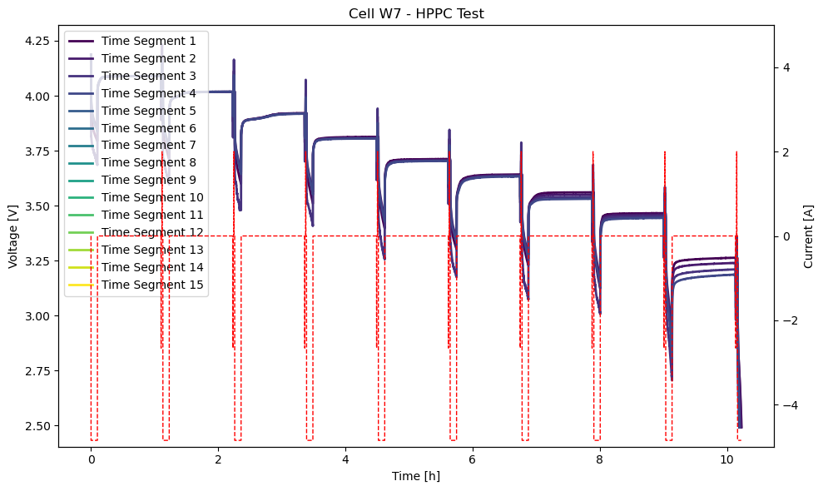
W7 HPPC Test

Slide 31

W9 HPPC Test

Slide 32

W10 HPPC Test

Slide 33
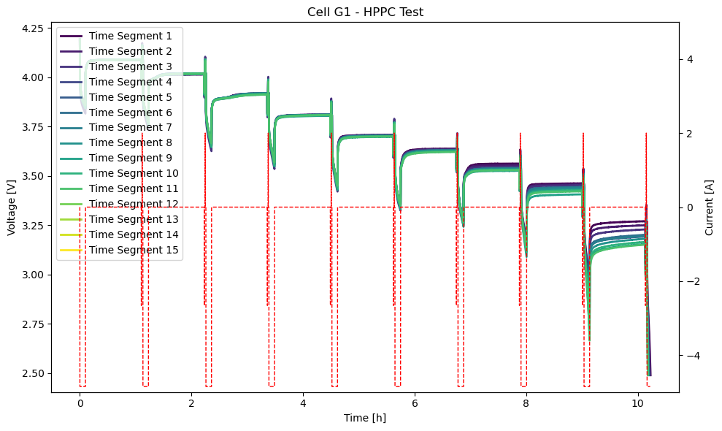
G1 HPPC Test

Slide 34

V4 HPPC Test

Slide 35
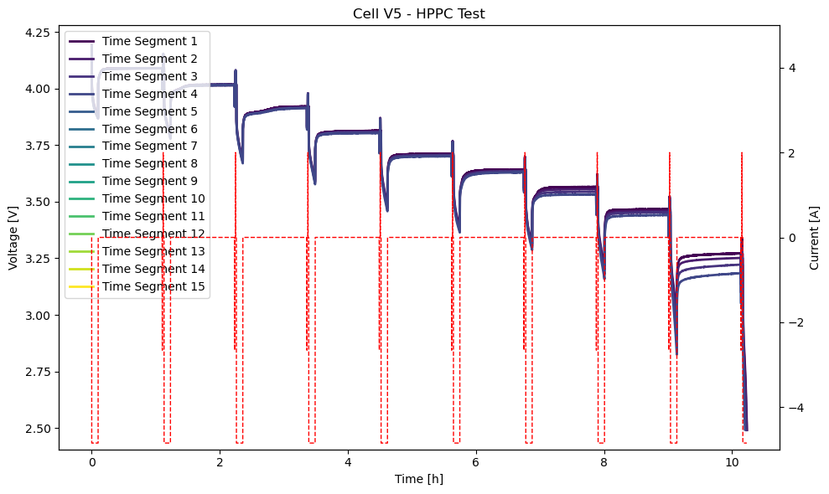
V5 HPPC Test

Slide 36
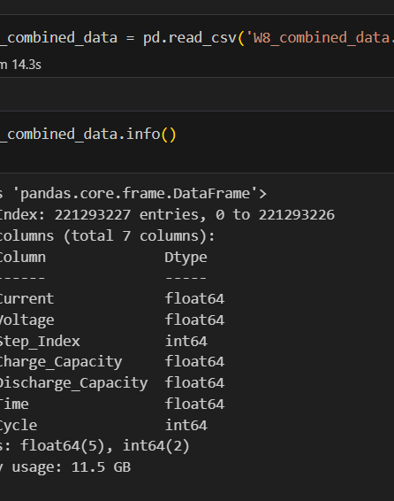
W8 Cycle
20 GB dataset
221 million entries
6 columns

Slide 37
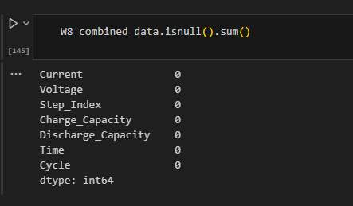

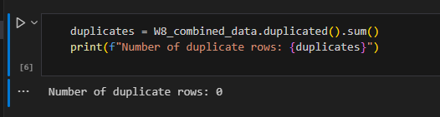
No null data
No duplicates

Slide 38
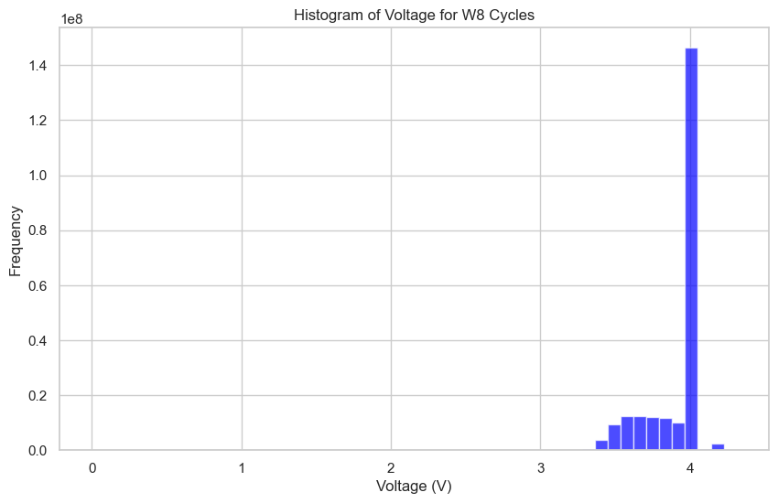
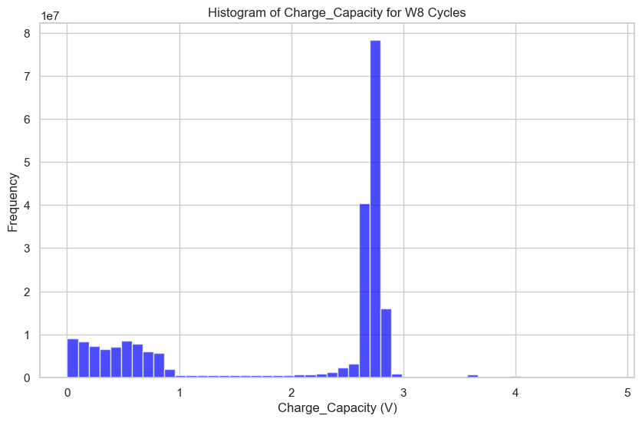
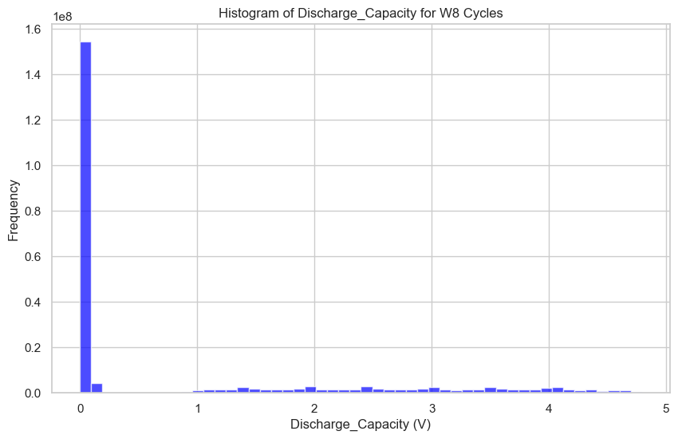
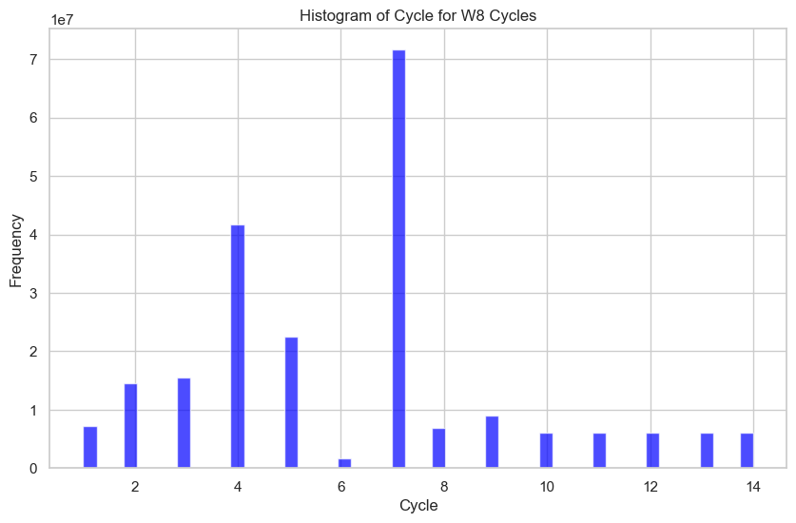
Check for outliers

Slide 39
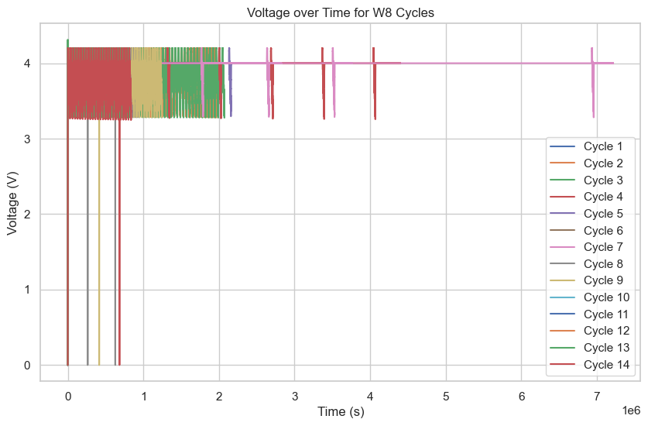
Voltage over Time

Slide 40
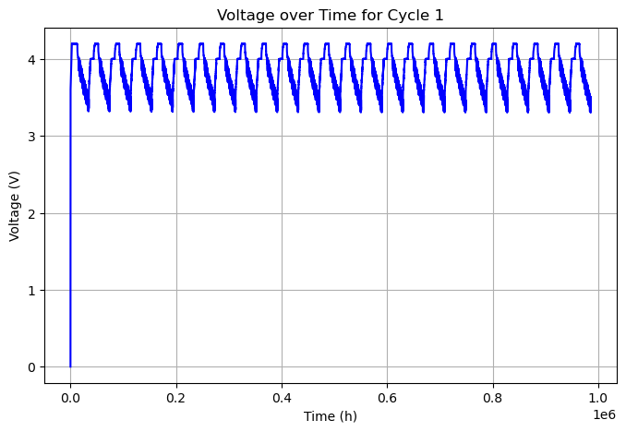

Slide 41
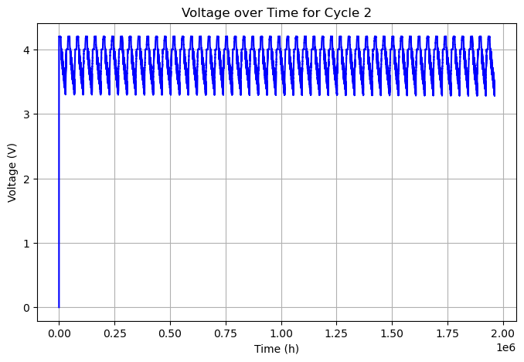

Slide 42


Slide 43
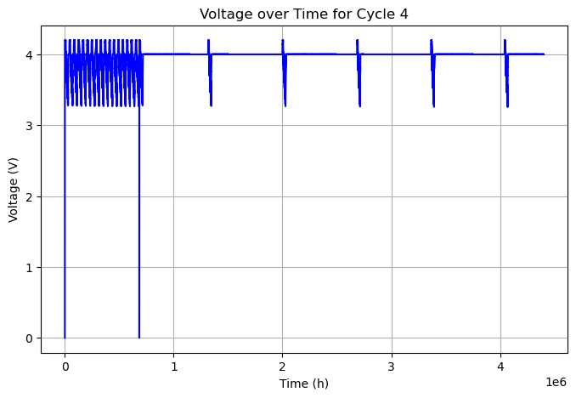

Slide 44
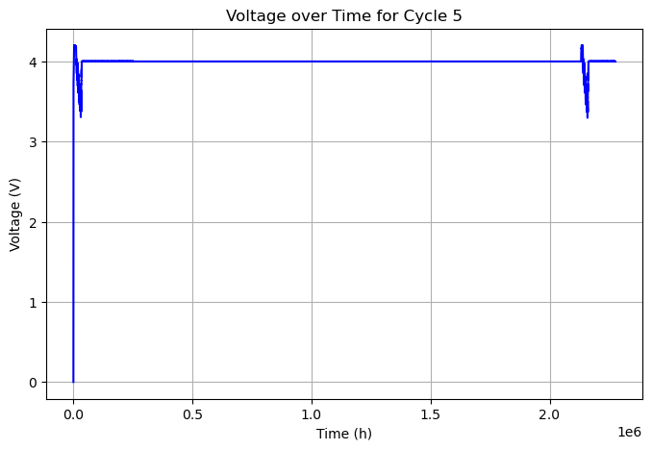

Slide 45
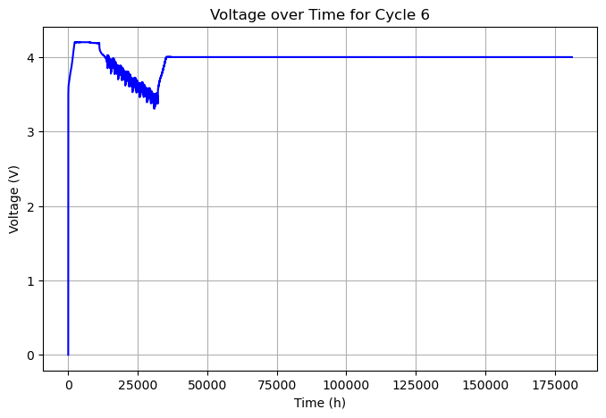

Slide 46
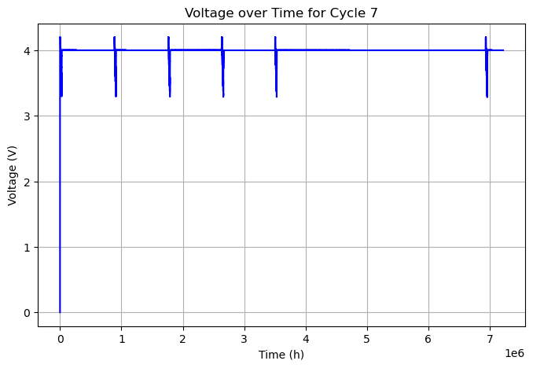

Slide 47
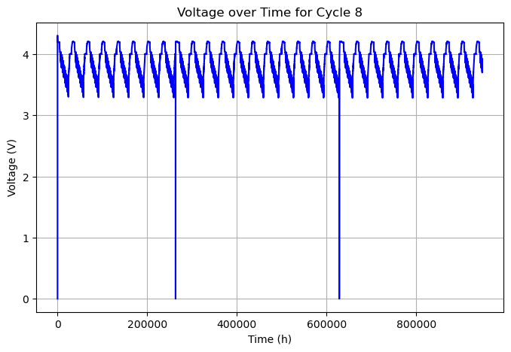

Slide 48
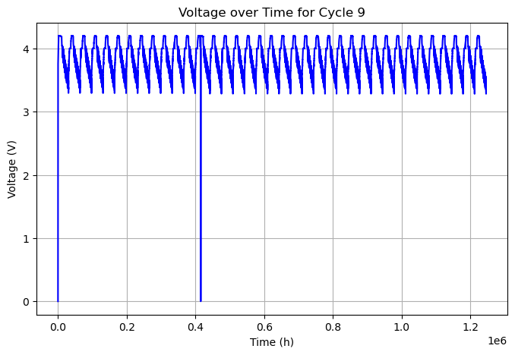

Slide 49


Slide 50


Slide 51


Slide 52


Slide 53


Slide 54


Slide 55


Slide 56


Slide 57


Slide 58


Slide 59


Slide 60


Slide 61


Slide 62


Slide 63


Slide 64


Slide 65


Slide 66


Slide 67


Slide 68


Slide 69


Slide 70


Slide 71


Slide 72


Slide 73


Slide 74



Linear Regression

Slide 75

Random Forest regression

Slide 76


XGBoost

Slide 77


LightGBM Regressor

Slide 78



Gradient Boost Regressor

Slide 79



Slide 80


Slide 81
What is being done
Fine-tune
GridSearchCV: Fine-tune the hyperparameters for XGBoost, LightGBM, and Gradient Boosting.
Ensure
Cross-Validation: Ensure the model generalizes well across different data splits.
Transfer
Transfer Prediction: Apply the trained model to predict the discharge capacity of another battery cell.

